Slide 1
CSM 491 - Graph Theory and Its Application
Lecture 4
by
Dr. Oliver Kornyo
Dept. of Computer Science

Slide 2
Paths and cycles
Lecture Outline
Connectivity
Connected and Disconnected Graph
Euler Graphs
Operation of Graphs
Hamiltonian Circuits

Slide 3
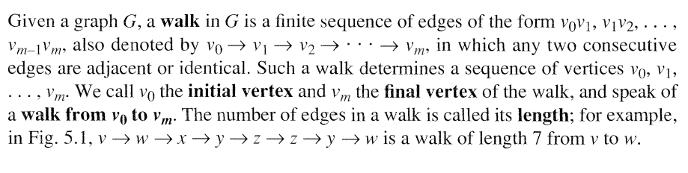
Connectivity

Slide 4
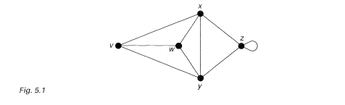
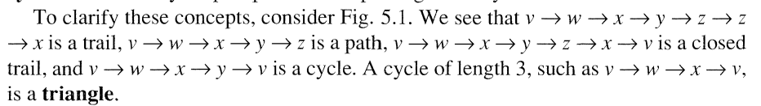
The Concept of a Walk
A walk in which all the edges are distinct is a trail. If, in addition, the vertices VQ, VJ, . . . , vm are distinct (except, possibly, VQ = vm), then the trail is a path. A Connectivity 27 path or trail is closed if VQ = vm, and a closed path containing at least one edge is a cycle. Note that any loop or pair of multiple edges is a cycle.

Slide 5
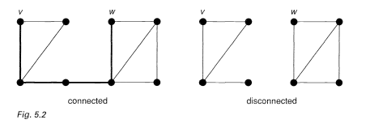
Connected and Disconnected
Note that a graph is connected if and only if there is a path between each pair of vertices (see Fig. 5.2).

Slide 6
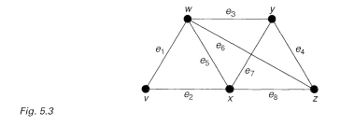
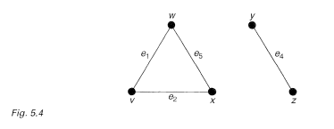
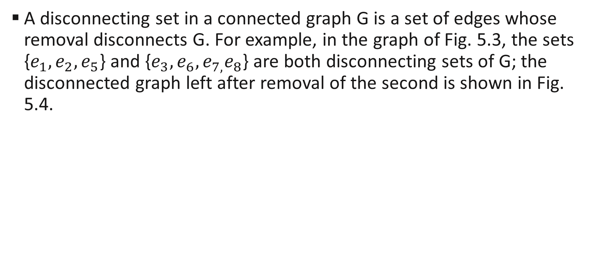
Disconnecting Set
A disconnecting set in a connected graph G is a set of edges whose removal disconnects G. For example, in the graph of Fig. 5.3, the sets {$e_{1},e_{2},e_{5}$} and {$e_{3},e_{6},e_{7,}e_{8}$} are both disconnecting sets of G; the disconnected graph left after removal of the second is shown in Fig. 5.4.

Slide 7
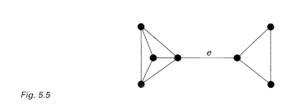
Cut Set
A cutset is a disconnecting set, no proper subset of which is a disconnecting set. In the above example, only the second disconnecting set is a cutset. Note that the removal of the edges in a cutset always leaves a graph with exactly two components.
If a cutset has only one edge e, we call e a bridge (see Fig. 5.5).

Slide 8
Edge Connectivity
If G is connected, its edge connectivity X(G) is the size of the smallest cutset in G. Thus X(G) is the minimum number of edges that we need to delete in order to disconnect G.
For example, if G is the graph of Fig. 5.3, then X(G) - 2, corresponding to the cutset { k. Thus the graph of Fig. 5.3 is 1-edge connected and 2-edge connected, but not 3-edge connected.

Slide 9
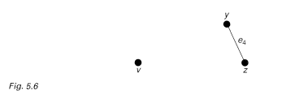
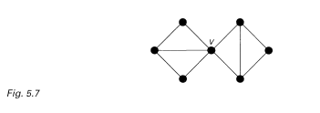
Separating Set
A separating set in a connected graph G is a set of vertices whose deletion disconnects G; recall that when we delete a vertex, we also remove its incident edges.
For example, in the graph of Fig. 5.3, the sets {w, x} and {w, x, y} are separating sets of G; the disconnected graph left after removal of the first is shown in Fig. 5.6. If a separating set contains only one vertex v, we call v a cut-vertex (see Fig. 5.7). These definitions extend immediately to disconnected graphs, as above.

Slide 10
EULER GRAPHS
A given connected graph G is an Euler graph if and only if all vertices of G are of even degree
One often encounters Euler lines in various puzzles. The problem common to these puzzles is to find how a given picture can be drawn in one continuous line without retracing and without lifting the pencil from the paper.

Slide 11
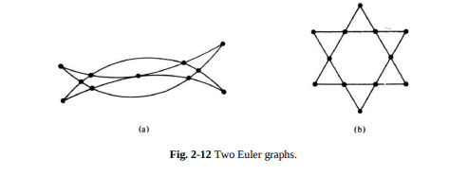
EULER GRAPHS - EXAMPLES
The drawing in Fig. 2-12(a) is called Mohammed’s scimitars and is believed to have come from the Arabs. The one in Fig. 2-12(b) is, of course, the star of David.
In defining an Euler line some authors drop the requirement that the walk be closed. For example, the walk a 1 c 2 d 3 a 4 b 5 d 6 e 7 b in Fig. 2-13, which includes all the edges of the graph and does not retrace any edge, is not closed. The initial vertex is a and the final vertex is b.

Slide 12
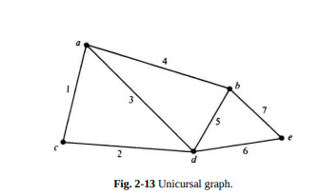
EULER GRAPH - UNICURSAL
We shall call such an open walk that includes (or traces or covers) all edges of a graph without retracing any edge a unicursal line or an open Euler line. A (connected) graph that has a unicursal line will be called a unicursal graph.
It is clear that by adding an edge between the initial and final vertices of a unicursal line we shall get an Euler line. Thus a connected graph is unicursal if and only if it has exactly two vertices of odd degree.

Slide 13
OPERATIONS ON GRAPHS
The union of two graphs G1 = (V1 , E1 ) and G2 = (V2 , E2 ) is another graph G3 (written as G3 = G1 ⋃ G2 ) whose vertex set V3 = V1 ⋃ V2 and the edge set E3 = E1 ⋃ E2 .
Likewise, the intersection G1 ⋂ G2 of graphs G1 and G2 is a graph G4 consisting only of those vertices and edges that are in both G1 and G2.
The ring sum of two graphs G1 and G2 (written as G1 ⊕ G2 ) is a graph consisting of the vertex set V1 ⋃ V2 and of edges that are either in G1 or G2 , but not in both.

Slide 14
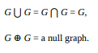
OPERATIONS ON GRAPHS (Cont’)
It is obvious from their definitions that the three operations just mentioned are commutative. That is,
If G1 and G2 are edge disjoint, then G1 ⋂ G2 is a null graph, and G1 ⊕ G2 = G1 ⋃ G2 . If G1 and G2 are vertex disjoint, then G1 ⋂ G2 is empty. For any graph G
If g is a subgraph of G, then G ⊕ g is, by definition, that subgraph of G which remains after all the edges in g have been removed from G. Therefore, G ⊕ g is written as G − g, whenever g ⊆ G. Because of this complementary nature, G ⊕ g = G − g is often called the complement of g in G

Slide 15
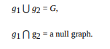
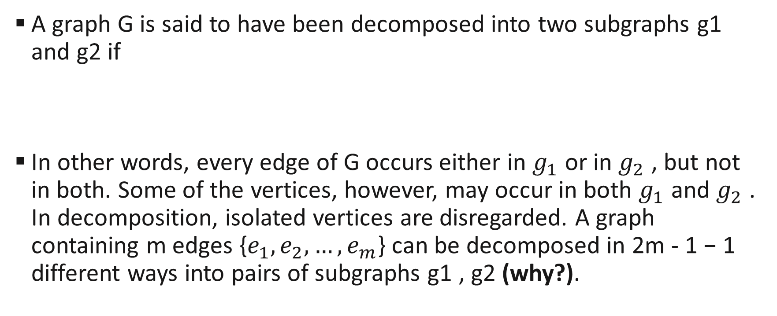
DECOMPOSITION
A graph G is said to have been decomposed into two subgraphs g1 and g2 if
In other words, every edge of G occurs either in $g_{1}$ or in $g_{2}$ , but not in both. Some of the vertices, however, may occur in both $g_{1}$ and $g_{2}$ . In decomposition, isolated vertices are disregarded. A graph containing m edges {$e_{1},e_{2},…,e_{m}$} can be decomposed in 2m - 1 − 1 different ways into pairs of subgraphs g1 , g2 (why?).

Slide 16
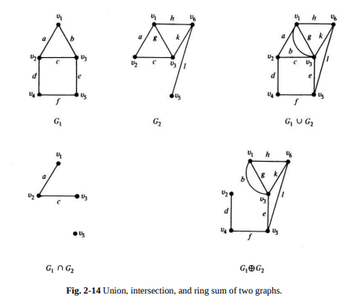
GRAPHICAL REPRESENTATION OF OPERATIONS

Slide 17
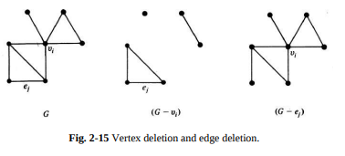
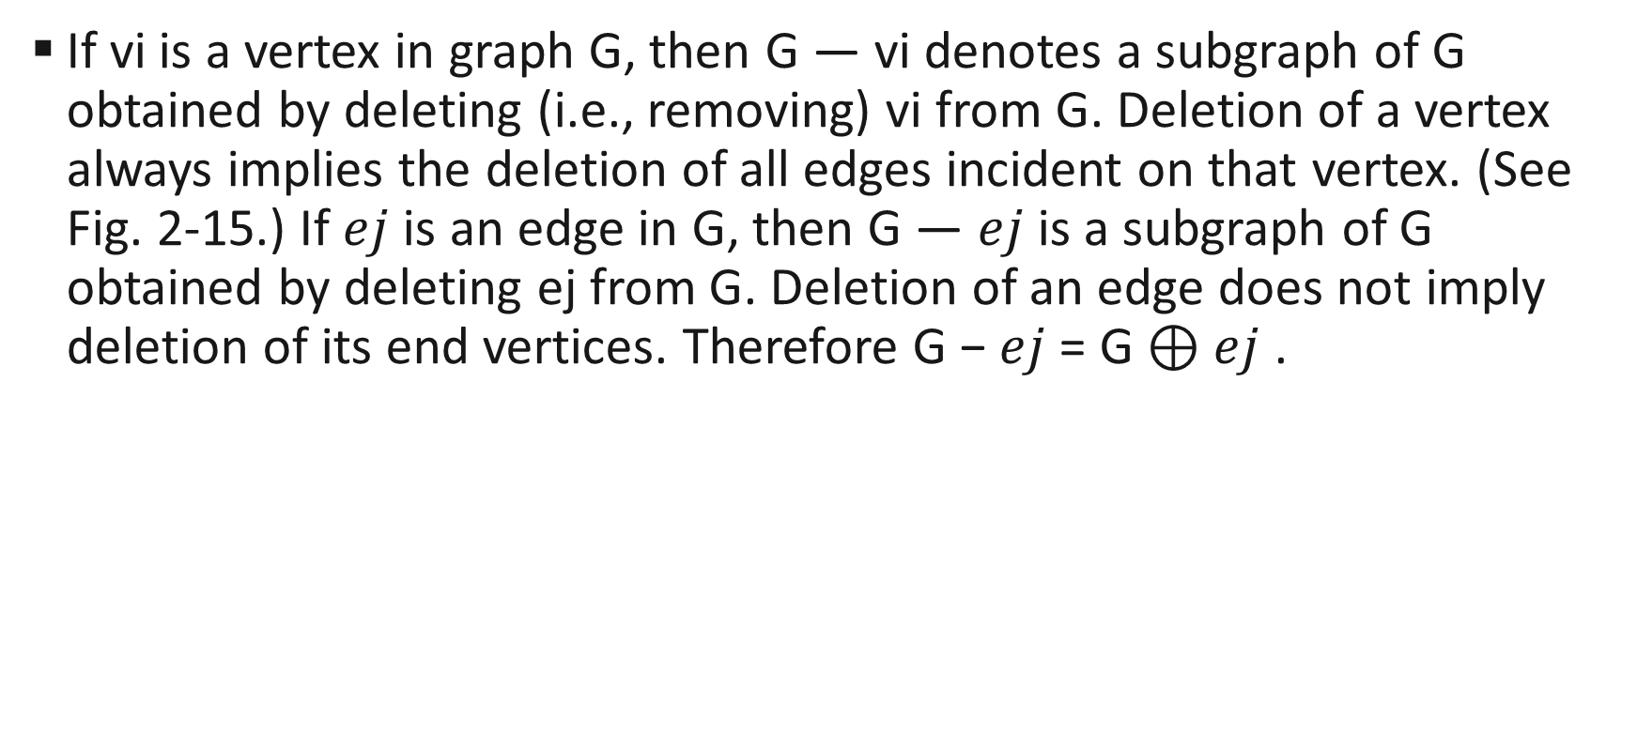
DELETION
If vi is a vertex in graph G, then G — vi denotes a subgraph of G obtained by deleting (i.e., removing) vi from G. Deletion of a vertex always implies the deletion of all edges incident on that vertex. (See Fig. 2-15.) If $ej$ is an edge in G, then G — $ej$is a subgraph of G obtained by deleting ej from G. Deletion of an edge does not imply deletion of its end vertices. Therefore G − $ej$ = G ⊕ $ej$ .

Slide 18
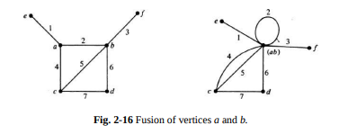
FUSION
A pair of vertices a, b in a graph are said to be fused (merged or identified) if the two vertices are replaced by a single new vertex such that every edge that was incident on either a or b or on both is incident on the new vertex. Thus, fusion of two vertices does not alter the number of edges, but it reduces the number of vertices by one. See Fig. 2-16 for an example.

Slide 19
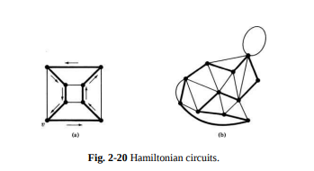
HAMILTONIAN CIRCUITS
Hamiltonian circuit in a connected graph is defined as a closed walk that traverses every vertex of G exactly once, except of course the starting vertex, at which the walk also terminates.
For example, in the graph of Fig. 2-20(a) starting at vertex v, if one traverses along the edges shown in heavy lines— passing through each vertex exactly once—one gets a Hamiltonian circuit. A Hamiltonian circuit for the graph in Fig. 2-20(b) is also shown by heavy lines

Slide 20
TRAVELING-MARKET WOMAN PROBLEM
A problem closely related to the question of Hamiltonian circuits is the traveling-salesman problem, stated as follows: A market woman is required to visit a number of cities during a trip. Given the distances between the cities, in what order should he travel so as to visit every city precisely once and return home, with the minimum mileage travelled?

Slide 21
Assignment 2
Q1. You are given a 10-piece domino set whose titles have the following set of dots: (1, 2); (1, 3); (1, 4); (1, 5); (2, 3); (2, 4); (2, 5); (3, 4); (3, 5); (4, 5). Discuss the possibility of arranging the tiles in a connected series such that one number on a title always touches the same number on its neighbour. (Hint: Use a five-vertex complete graph and see if it is an Euler graph.)
Q2. A round-robin tournament (when every player plays against every other) among n players (n being an even number) can be represented by a complete graph of n vertices. Discuss how you would schedule the tournaments to finish in the shortest possible time.

Slide 22
THANK YOU

